Slide 1
Implementation of CRUD operations using Core MVC in ASP.NET

Slide 2
What is MVC?
architectural pattern that separates an application into three main logical components
Model, View and Controller
Separates logic , interface and functionality
Organized programming
Allows multiple programmers to work on the same project

Slide 3
MODEL
Responsible for getting and manipulating the data
Interacts with a database like MySQL or MongoDB (SELECT, UPDATE, DELETE and INSERT)
Communicates with the controller

Slide 4
VIEW
What user sees when they interact with the application – User Interface
Controller communicates with View and Model
If we use just HTML and CSS we cannot use variables or use logic to show the user interface, we need template engines for that
Can pass dynamic values from the controller

Slide 5
CONTROLLER
Acts as a middle man between model and view
Receives input from the user
User clicking on a link Get request, filling a form(POST request)

Slide 6
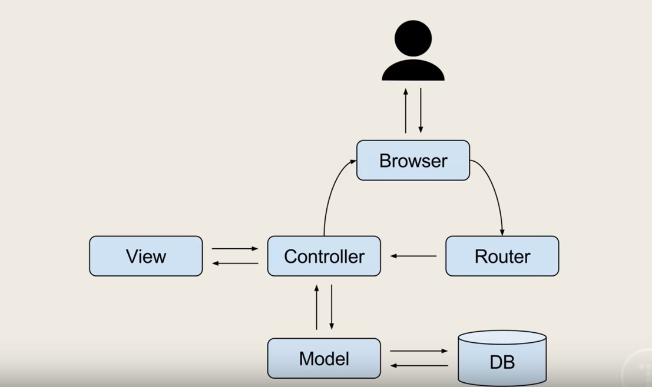
How MVC works?

Slide 7
Project Implementation
Version of the MVC Framework used is 4.3.2.
Used Visual Studio and entity framework 4.3.2 to create ASP.NET MVC application and SQL Server management studio for managing the database.
In this project I have customized the create, read, update, delete (CRUD) code that the MVC scaffolding automatically creates for us in controllers and views.

Slide 8
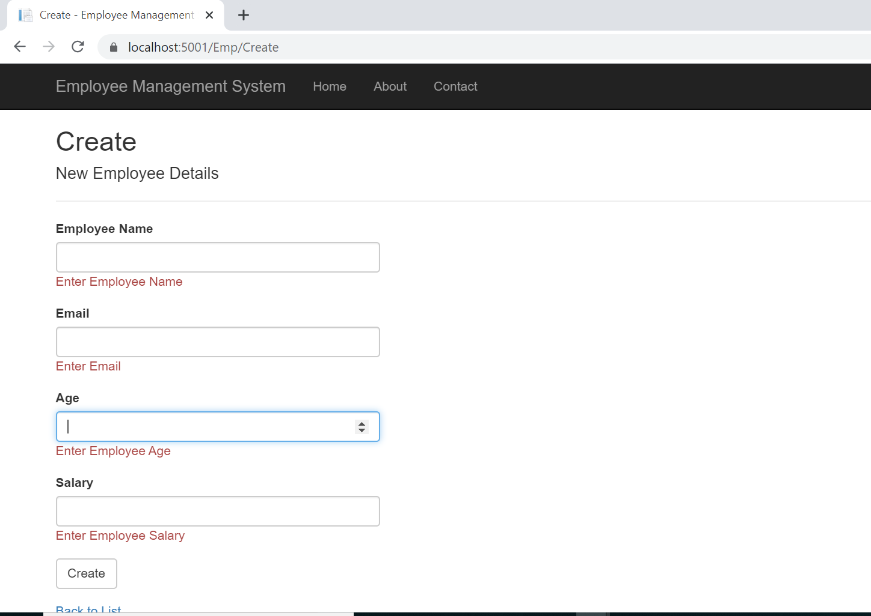
Used to add new employee details to the system. Has validation checks.
CREATE

Slide 9
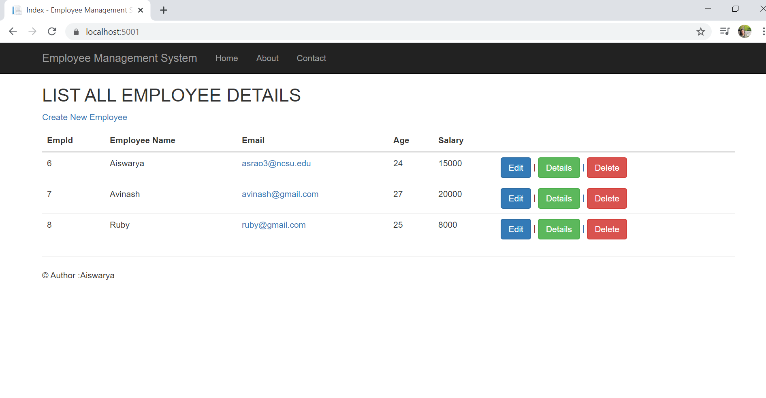
Once created, it redirects to home page where we can see the list of all the employees enrolled in the system

Slide 10
We can edit the employee details. Changes made will get reflected in the database as well
EDIT

Slide 11
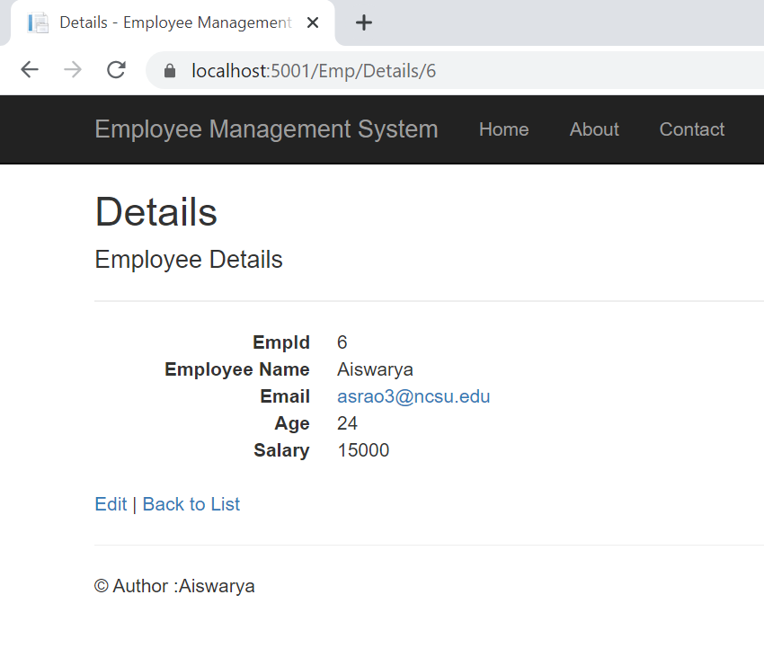
Clicking on details will show the details of the selected employee. It performs the READ operation from the database.
DETAILS

Slide 12
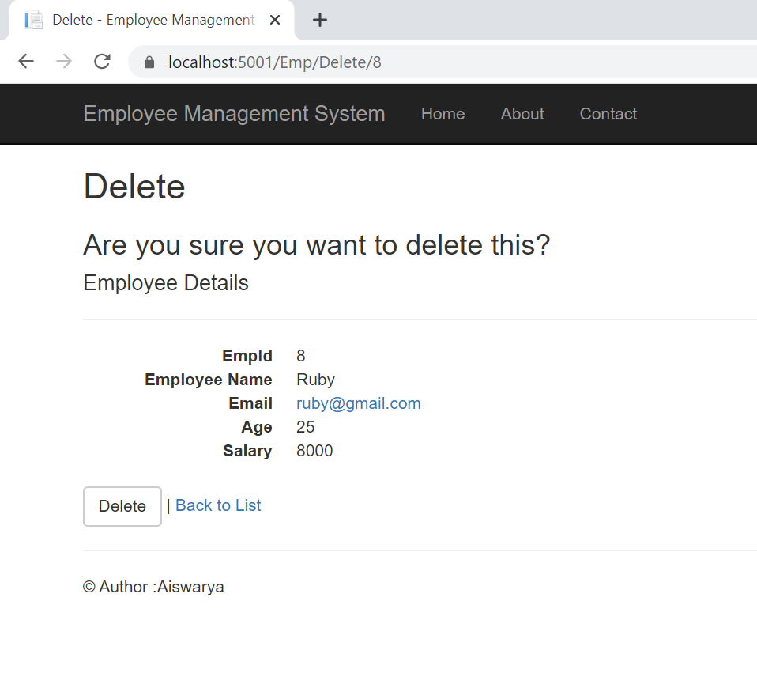
Clicking on delete operation will ask the user to confirm the deletion operation. Delete will permanently delete the employee details from the database.
DELETE

